Slide 1
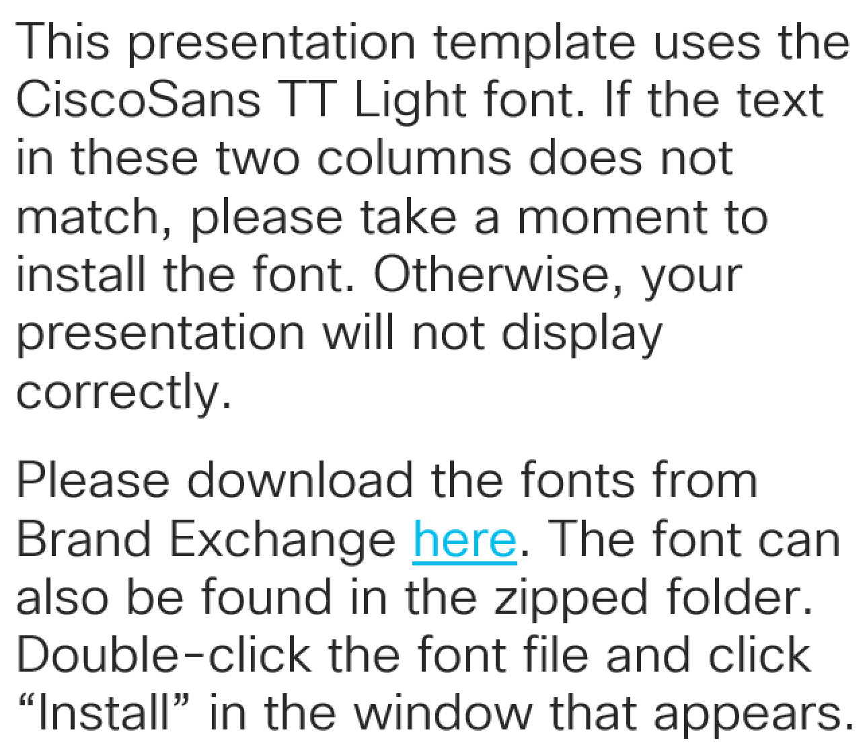
Please read
This presentation template uses the CiscoSans TT Light font. If the text in these two columns does not match, please take a moment to install the font. Otherwise, your presentation will not display correctly.
Please download the fonts from Brand Exchange here. The font can also be found in the zipped folder. Double-click the font file and click “Install” in the window that appears.

Slide 3
Presentation Title Goes Here
Subtitle goes here
Presenter Name and Title @Twitter_handle
Session ID

Slide 4
Presentation Title Goes Here
Subtitle goes here
Presenter Name and Title @Twitter_handle
Session ID

Slide 5

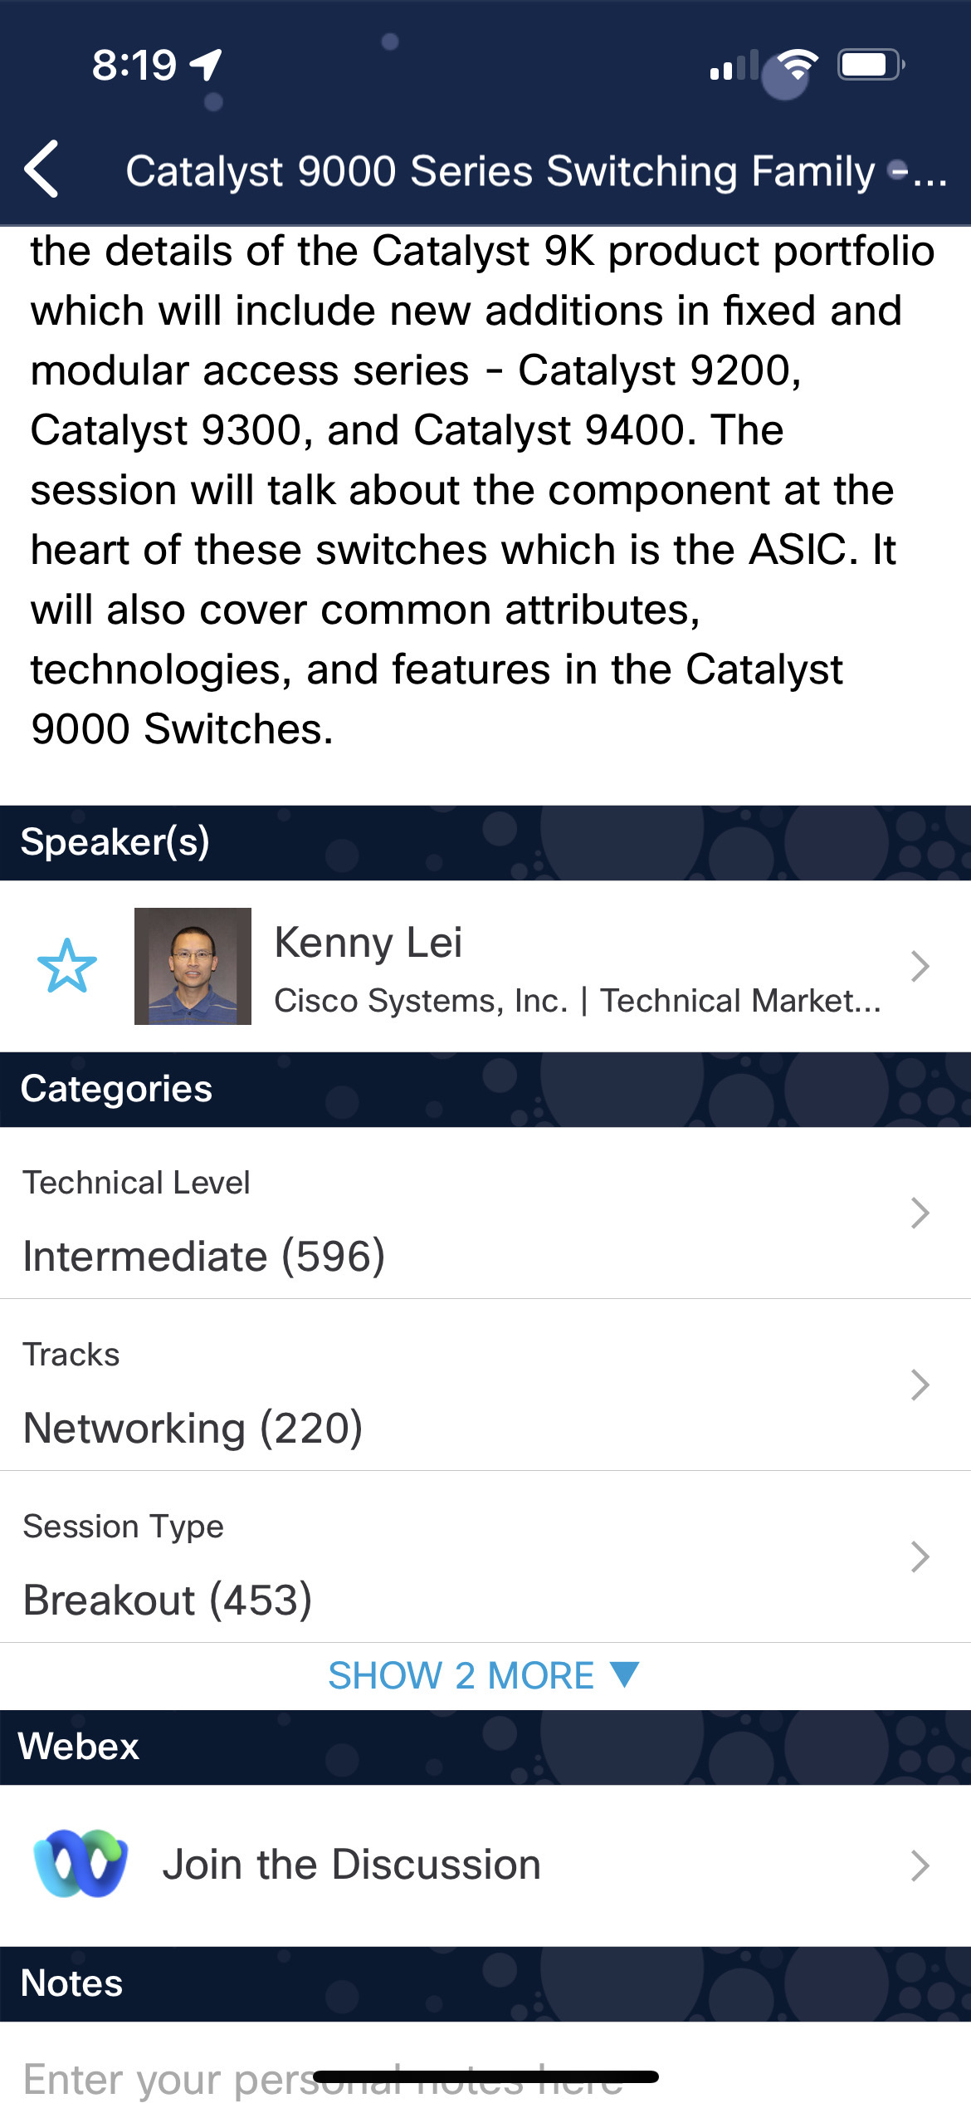
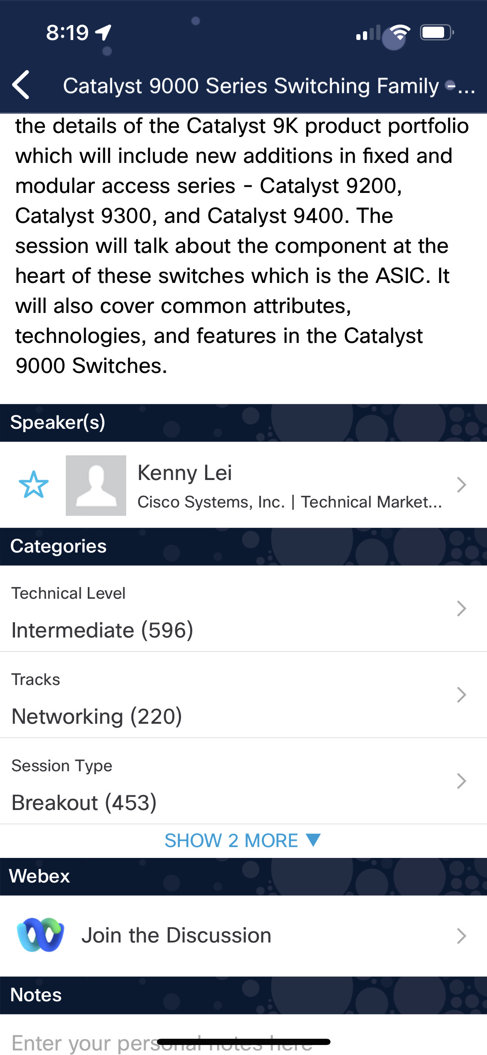

Cisco Webex App
Questions? Use Cisco Webex App to chat with the speaker after the session
How
1
Find this session in the Cisco Live Mobile App
Click “Join the Discussion”
Install the Webex App or go directly to the Webex space
Enter messages/questions in the Webex space
2
3
Enter your personal notes here
4
Webex spaces will be moderated by the speaker until June 9, 2023.
https://ciscolive.ciscoevents.com/ciscolivebot/#BRKXXX-xxxx
© 2023 Cisco and/or its affiliates. All rights reserved. Cisco Public
5

Slide 6
Introduction
Second title goes here
Third title goes here
Fourth title goes here
Fifth title goes here
Conclusion

Slide 7
Introduction
Second title goes here
Third title goes here
Fourth title goes here
Fifth title goes here
Conclusion

Slide 8
Best practices for creating slides
Make sure every slide is assigned to a layout from the new template.
Reset slides to the correct layout using Home/Layout (both PC and Mac).
Reset a slide back to the correct formatting using:
Home/Reset (PC)
Home/Layout/Reset Layout to Default Settings (Mac)
Resetting a slide to the proper layout can resolve issues like disappearing titles or misplaced bullets.
If slide numbers are not formatting correctly after the slides have been moved to the new template and connected to the correct layout, then turn the slide numbers off and then back on.
Home/Replace (PC) Format/Replace Fonts (Mac) allows you to replace fonts globally.

Slide 9
Best practices for creating slides
Your presentation will be saved and posted as a PDF, so what you see onscreen in Normal Mode is how the PDF will appear.
Split up a series of animations over several slides so key information is not hidden when saved as a PDF. Include a final slide with all elements in place.
If you include log files in your slides, please make sure they come from a lab system—not a customer production system that could contain sensitive customer information.
Use text for just the most important data, with a minimum font size of 14 pt.
If you have a number of text slides in a row, try to keep the same size text across all the slides to make it easier to read in the flow.

Slide 10
Steps for filling in session IDs
Once you have entered your Session ID on the Title Slide:
Copy the Session ID
Insert / Header & Footer / Paste the Session ID into the Footer box
Ensure Slide number and Footer checkboxes are marked
Click “Apply to All”

Slide 11
Segue

Slide 12
Segue 2

Slide 13
Segue 3

Slide 14
Segue 4

Slide 15
Segue 5

Slide 16
Video

Slide 17
Video 2

Slide 18
Demo

Slide 19
Demo 2

Slide 20
Color palette
Hero
Use the hero palette colors as much as possible.
Accent colors should only be used to call attention to important details, such as in a chart.
Sky Blue
R 0
G 188
B 235
Midnight Blue
R 13
G 39
B 77
Accent
Medium Blue
R 0
G 81
B 175
Green
R 116
G 191
B 75
Orange
R 251
G 171
B 24
Red
R 227
G 36
B 27

Slide 21
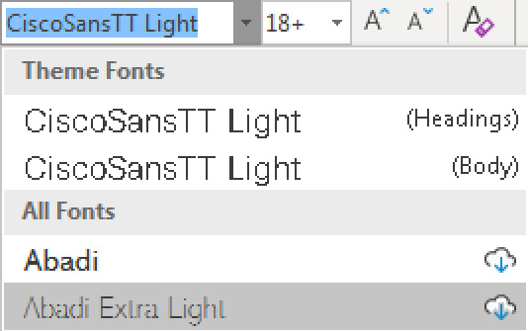
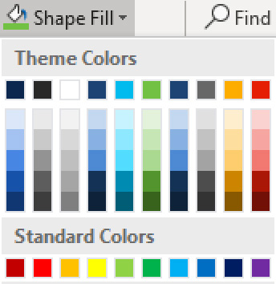
Only use the themes provided
Always use the template themes. It ensures consistency and reduces editing time when you share content between presentations.
Theme fonts
PowerPoint provides two theme fonts – for headings and body. They are found at the top of the font menu.
Do not select fonts from the “All Fonts” section of the list.
Theme colors
Our brand colors are included in the theme color section. Use only these colors and associated tints/shadows.
Do not use Standard Colors or create custom colors.

Slide 22
Seven tips for better presentations
Tell a story—make them care
Start with what’s most important to them
Keep it simple, and short
Use more slides with less on them, and cut any slides that you can
Use clear, natural language
Make it a conversation and leave time to listen
Tell them what to do next—get them to act

Slide 23
Bullet slide / sentence case / size 28
CiscoSansTT Light font is the only font used in the presentation
Exception: Courier can be used to represent code
Body copy uses sentence case, size 20, left aligned
Sub-bullets are size 18 and indented
Hyperlink: www.cisco.com
Use Cisco highlight color when emphasizing words, do not italicize

Slide 24
Dark Bullet slide / sentence case / size 28
CiscoSansTT Light font is the only font used in the presentation
Exception: Courier can be used to represent code
Body copy uses sentence case, size 20, left aligned
Sub-bullets are size 18 and indented
Hyperlink: www.cisco.com
Use Cisco highlight color when emphasizing words, do not italicize

Slide 25
Layout: Title and subtitle and bullet
Subtitle: Size 18, left aligned
CiscoSansTT Light font is the only font used in the presentation
Exception: Courier can be used to represent code
Body copy uses sentence case, size 20, left aligned
Sub-bullets are size 18 and indented
Hyperlink: www.cisco.com
Use Cisco highlight color when emphasizing words, do not italicize

Slide 26
Layout: Dark Title and subtitle and bullet
Subtitle: Size 18, left aligned
CiscoSansTT Light font is the only font used in the presentation
Exception: Courier can be used to represent code
Body copy uses sentence case, size 20, left aligned
Sub-bullets are size 18 and indented
Hyperlink: www.cisco.com
Use Cisco highlight color when emphasizing words, do not italicize

Slide 27
Layout: Title and subtitle
Subtitle: Size 18, left aligned

Slide 28
Layout: Bullet title only

Slide 29
Layout: Dark Bullet title only

Slide 30
Layout: Bullet heavy text two-column
Use this layout when you have to show six or more bullets
Text size should be approximately 20 pt
Use paragraph spacing to clearly separate each point
Use bold text sparingly
Use this layout when you have to show six or more bullets
Text size should be approximately 20 pt
Use paragraph spacing to clearly separate each point
Use bold text sparingly

Slide 31
Layout: 2 Column with title and subtitle
Subtitle
Use this layout when you have to show six or more bullets
Text size should be approximately 18 pt
Use paragraph spacing to clearly separate each point
Use bold text sparingly
Use this layout when you have to show six or more bullets
Text size should be approximately 18 pt
Use paragraph spacing to clearly separate each point
Use bold text sparingly

Slide 32
Layout: Title and 3 column bullets
Use this layout when you have to show 3 columns of text
Use this layout when you have to show 3 columns of text
Use this layout when you have to show 3 columns of text

Slide 33
Title and subtitle and bullet for heavy graphics
Subtitle
Use this layout for lengthy bullet text that also has a subtitle

Slide 34
Layout: Title and bullet for heavy text
Use this layout for lengthy bullet text

Slide 35
Layout: Title and subtitle for heavy graphics
To be used for large network diagrams that have a title and subtitle

Slide 36
Layout: Title only for heavy graphics

Slide 37
This is a sample headline
Secondary information goes here
Keep bullets brief
Use line spacing to clearly separate each point
Use the two-column layout for text-heavy slides
Put your main point here. Use this space for a brief paragraph – no more than two or three sentences. Font size should be around 24 pt.

Slide 40

Use this space to provide a bit of detail.
#CiscoLive
© 2022 Cisco and/or its affiliates. All rights reserved. Cisco Public

Slide 41
“Quote text is left aligned, with a point size of 36 points.”
Source Name
Company XYZ

Slide 42
Slide title
Heading 1 | Heading 2 | Heading 3
100 | 100 | 100
100 | 100 | 100
100 | 100 | 100
100 | 100 | 100
100 | 100 | 100
100 | 100 | 100
Enter source information here

Slide 43
Bar charts
Enter source information here

Slide 44
Line charts
Enter source information here

Slide 45



Fill out your session surveys!
Attendees who fill out a minimum of four session surveys and the overall event survey will get Cisco Live-branded socks (while supplies last)!
Attendees will also earn 100 points in the Cisco Live Challenge for every survey completed.
These points help you get on the leaderboard and increase your chances of winning daily and grand prizes

Slide 46

Continue your education
Visit the Cisco Showcase for related demos
Book your one-on-one Meet the Engineer meeting
Attend the interactive education with DevNet, Capture the Flag, and Walk-in Labs
Visit the On-Demand Library for more sessions at www.CiscoLive.com/on-demand

